Slide 1
Introduction to Data Science
CS3300 Data Science
RJ Nowling

Slide 2
Introductions
What is your name?
What is your major?
What did you do this summer?
What excites you about Data Science?
Do you know what you want to do after graduation?

Slide 3
Who am I?
Dr. RJ Nowling
Ph.D. in Computer Science & Engineering
University of Notre Dame
Simulating dynamics of molecules (Molecular Dynamics)
Genomes of insect vectors (Bioinformatics)
Industry Experience
2 years at Red Hat – working on open-source big data platforms
2 years at AdRoll – Data Science Engineering (everything for a real-time recommendation system)
1 year at MSOE ☺
In my spare time, I like to ride my bike and take my dogs to the dog park

Slide 4
Reading
Chapter 1 of The Data Science Design Manual

Slide 5
What is Data Science?
Extract actionable knowledge from data – Dr. Jay Urbain
“The ability to take data – to be able to understand it, to process it, to extract value from it, to visualize it, to communicate it.”
Application of the scientific method to data
Exploring data to generate hypotheses
Evaluating hypotheses with visualizations, predictive models, and statistics
Communicating those hypotheses and evidence to others

Slide 6
Modes of Inquiry: Hypothesis Driven
Traditional scientific method
We form a hypothesis
We design an experiment (including collecting data) to test the hypothesis
If the experiment is able to reject or disprove the hypothesis, we generate a new hypothesis
Otherwise, we design another experiment to test the hypothesis
Eventually, if we are unable to disprove the hypothesis, it becomes a law

Slide 7
Modes of Inquiry: Method Driven
Traditional engineering approach
We focus on understanding a method or technique
We identify when and how to apply that technique
We becomes experts at applying the technique

Slide 8
Modes of Inquiry: Data Driven
We start with a data set
We explore the data set to identify patterns
From these patterns, we ask questions and form hypotheses
We may be able to use the data to answer the hypothesis or may need to design a new experiment
This is a new mode of inquiry and what makes Data Science different from traditional science and engineering.

Slide 9
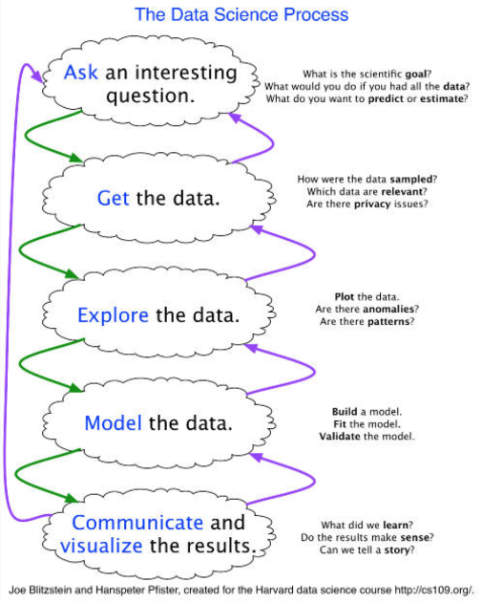
Data Science Process

Slide 10
Online Advertising Infrastructure Case Study
A is an online advertising platform
A uses user data (e.g., web pages viewed) from your web site to determine which ads to show users and how much to pay for those ads
One part of A’s system is a recommendation system – used to generate candidate ads for a user which are refined by another system further down the pipeline
Recommendations generated for 1 billion cookies per day by a batch job

Slide 11
Online Advertising Infrastructure Case Study
Or "why am I getting a paged in the middle of the night saying that our machine learning pipeline hasn't finished running?"
(More profanities in real life…)

Slide 12
Machine Learning Pipeline

Slide 13
Problem
We monitor pipeline completion times
Pipeline run times started going up
Potential they won't complete in desired period
More data -> longer run time
More data -> higher infrastructure costs (e.g., more EC2 instances and higher S3 storage costs)

Slide 14
Data Collection
Customers inject code into their web site to allow A to track visitors' page views
Record every ad impression and click

Slide 15
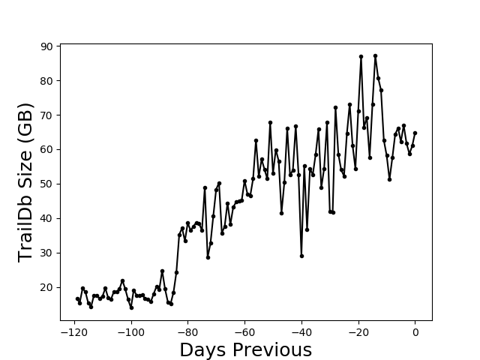
Daily Data Size Over Last 120 Days

Slide 16
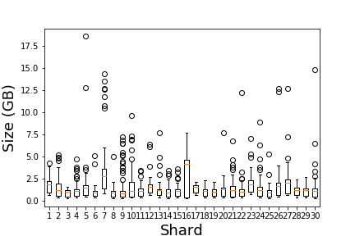
Daily Size Distributions by Shard

Slide 17
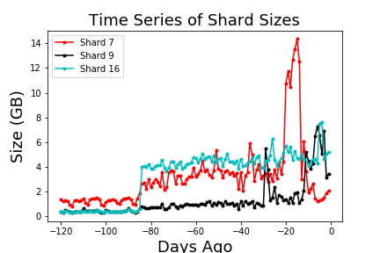
Time Series of Chosen Shards

Slide 18
Action Items
Duplicate data during data model transition
Wait until transition is complete
Mobile advertiser data
Filter out data
Highly-redundant user attribute data from third party vendor
Short term: Filter out third-party user attribute data
Medium term: Implement lightweight monitoring and alerting system that checks properties of the data over time
Longer term: De-duplicate data and make available as source for feature engineering

Slide 19
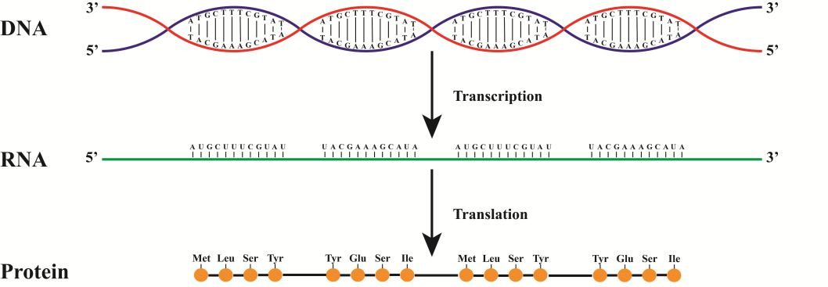
Biochemistry

Slide 20
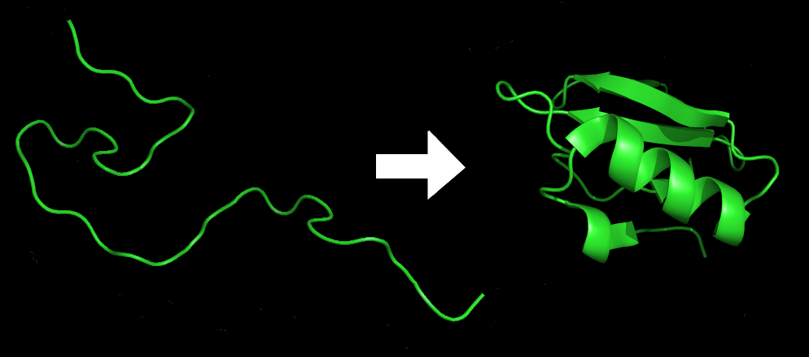
Protein Folding

Slide 21
Molecular Dynamics
Simulate dynamics of proteins, liquids, etc. at the atomic level
NTL9
B1 domain of Protein G
Very resource intensive
GPUs
Thousands of machines
Folding@Home
Generates terabytes of very high dimensional data

Slide 22
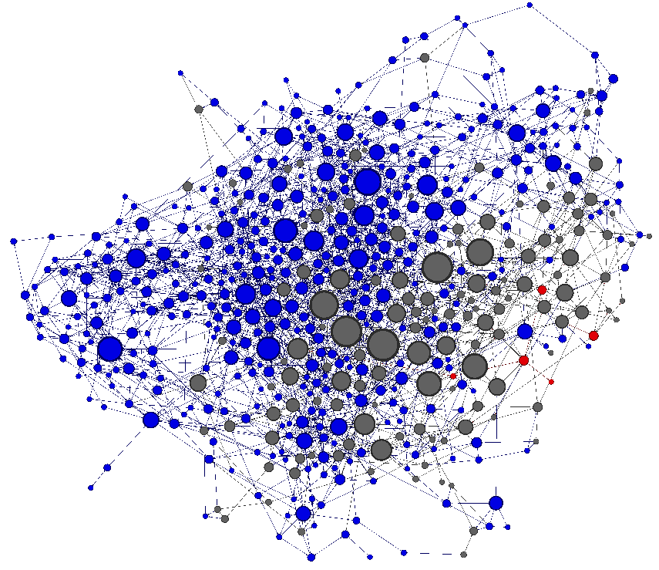
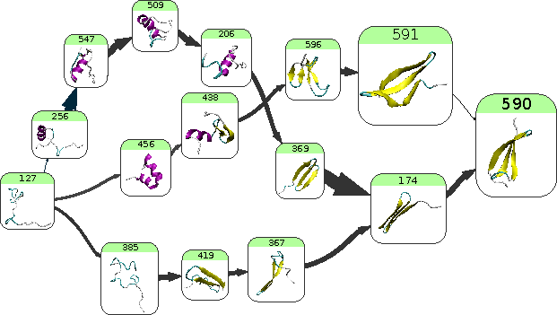
Folding Pathways with Clustering and Markov Models

Slide 23
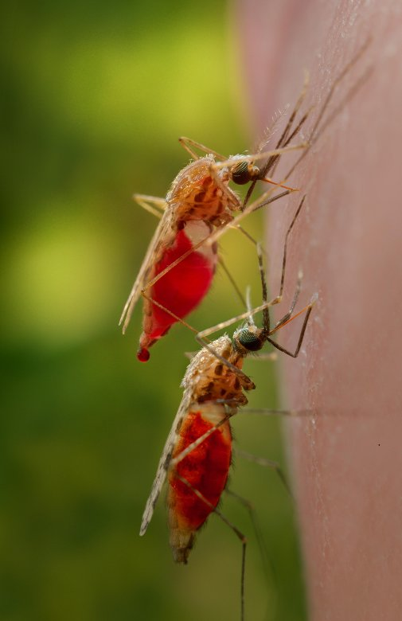
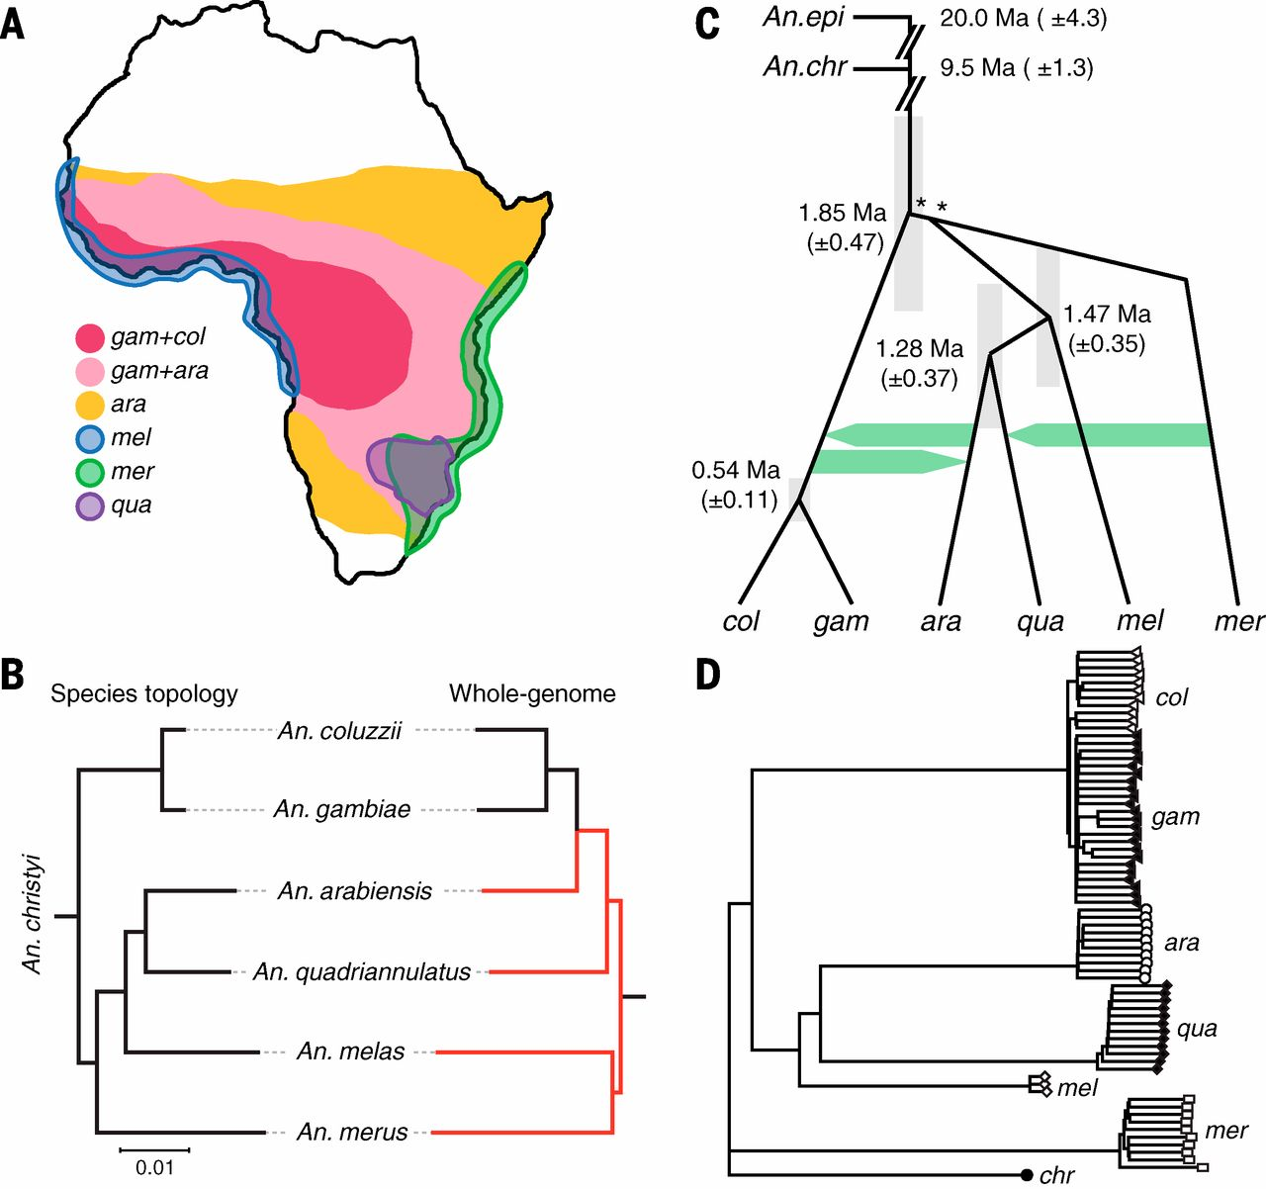
Biology (Genomics)

Slide 24
What is an Inversion?
Notes:
Karyotype map from Maria – "gambiae karyotype map"

Slide 25
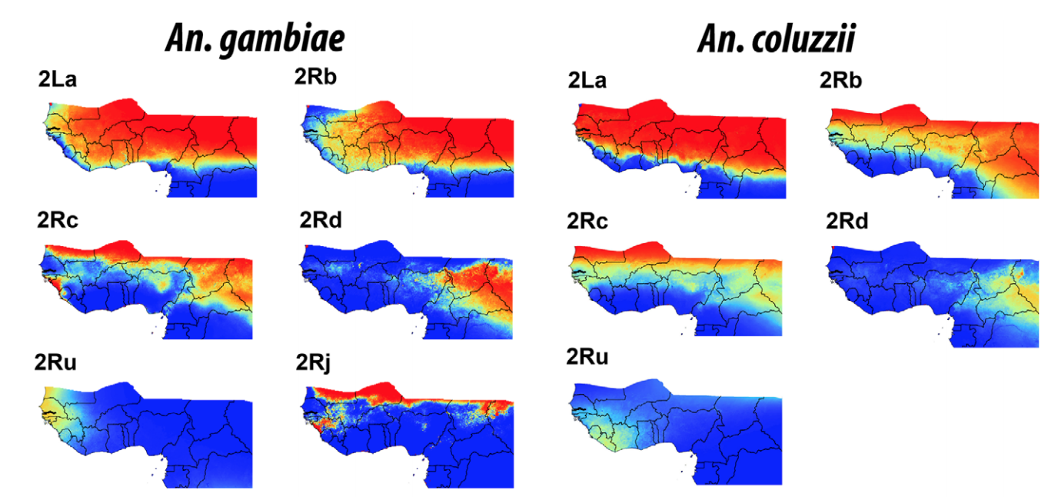
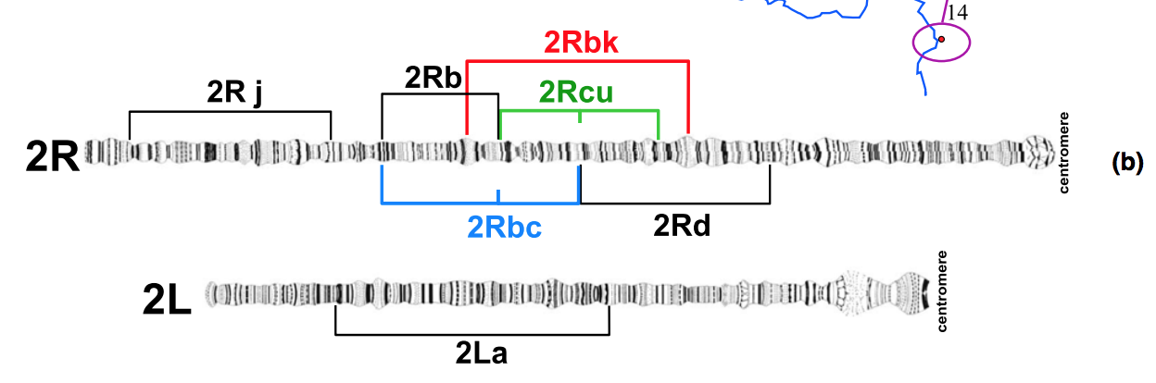
Inversions
Ayala, et al. Evolution. 2017; Caputo, et al. Mol. Ecology. 2014.

Slide 26
Importance of Inversions
Thought to play an important role in ecological adaptation by enabling the accumulation of beneficial alleles Fuller, et al. Bioarxiv. 2017.; Love, et al. Mol. Ecol. 2016.
2La in Anopheles gambiae
Thermal tolerance of larvae Rocca, et al. Malaria Journal. 2009.
Enhanced desiccation resistance Gray, et al. Malaria Journal. 2009.
Susceptibility to malaria parasite species Riehle, Elife. 2016.
Notes:
reduced recombination

Slide 27
Single Nucleotide Polymorphisms (SNPs)
An. gambiae | ATGCATGCATTCATGC
An. gambiae | ATGCATCCATACATGC
An. gambiae | ATGCATGCATTCATGC
An. gambiae | ATGCATCCATACATGC
An. coluzzii | AAGCATGCATTCATGC
An. coluzzii | AAGCATGCATACATGC
An. coluzzii | AAGCATGCATTCATGC
An. coluzzii | AAGCATGCATACATGC

Slide 28
Single Nucleotide Polymorphisms (SNPs)
An. gambiae | T G T
An. gambiae | T C A
An. gambiae | T G T
An. gambiae | T C A
An. coluzzii | A G T
An. coluzzii | A G A
An. coluzzii | A G T
An. coluzzii | A G A

Slide 29
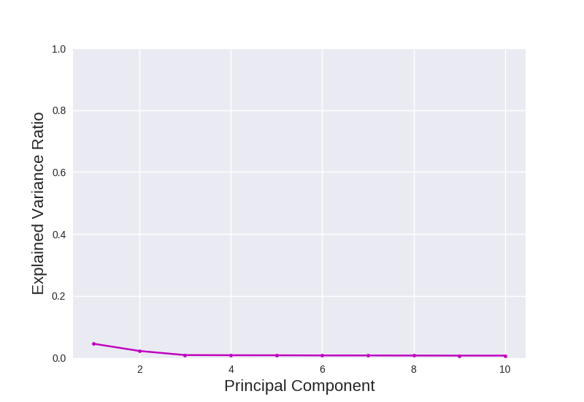
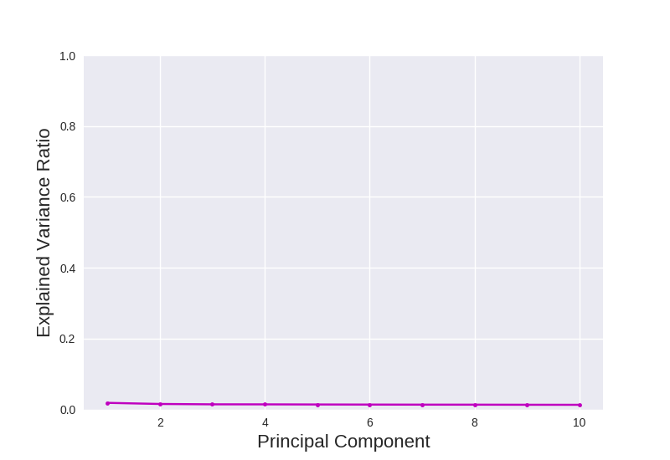
Picking Number of Components

Slide 30
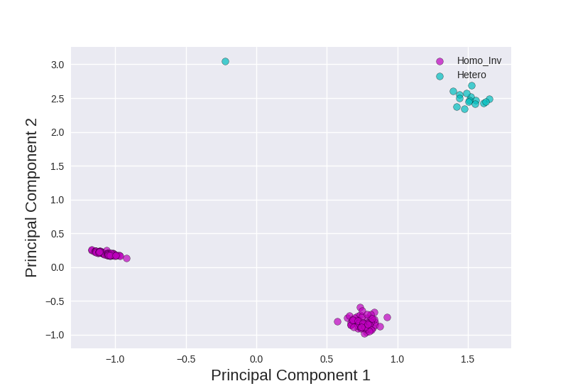
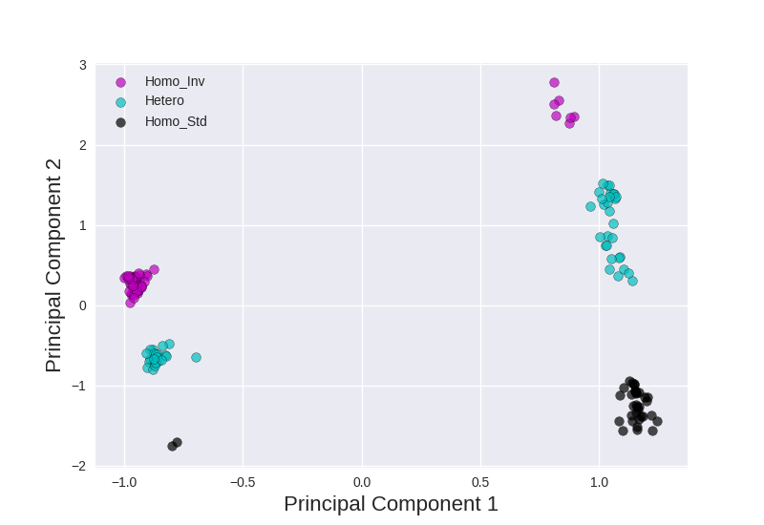
PCA of Anopheles Mosquitoes

Slide 31
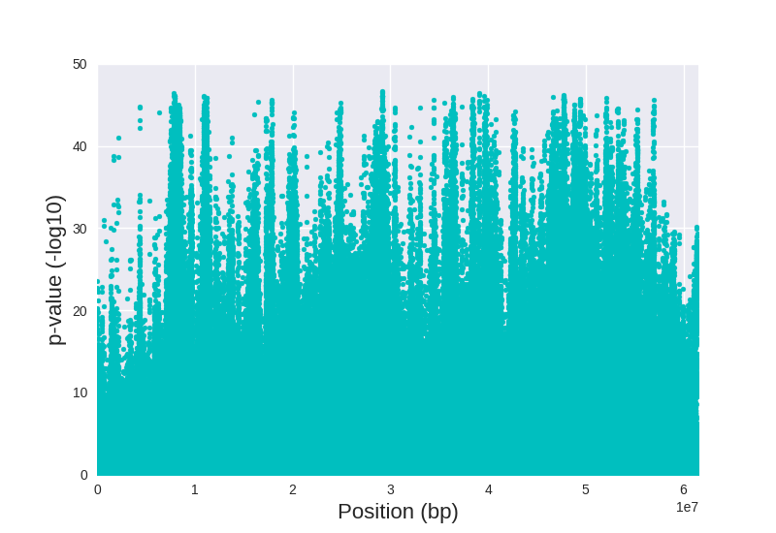
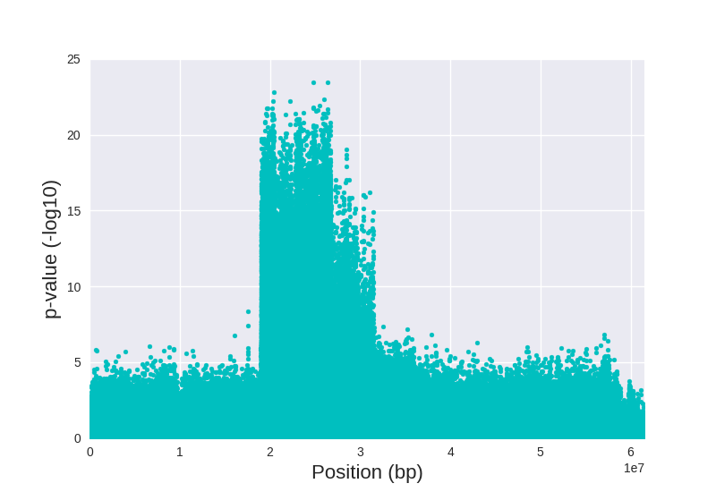
PC-SNP Associations on Anopheles 2R

Slide 32
Data Science Skills / What You'll Learn
Data munging – parsing, scraping, formatting, cleaning data
Scientific process – exploring data to observe patterns, stating a hypothesis, and proving or disproving the hypothesis (e.g., using models, statistics, or visualizations)
Communication and Visualization – reports, tables, graphs, interactive data applications, summary statistics
Statistics – traditional analysis
Machine learning – modeling relationships, prediction
Domain knowledge – business, science, etc.

